Slide 1
WELCOME TO ALL
PROTOTYPE OF OUR PROJECT

Slide 2
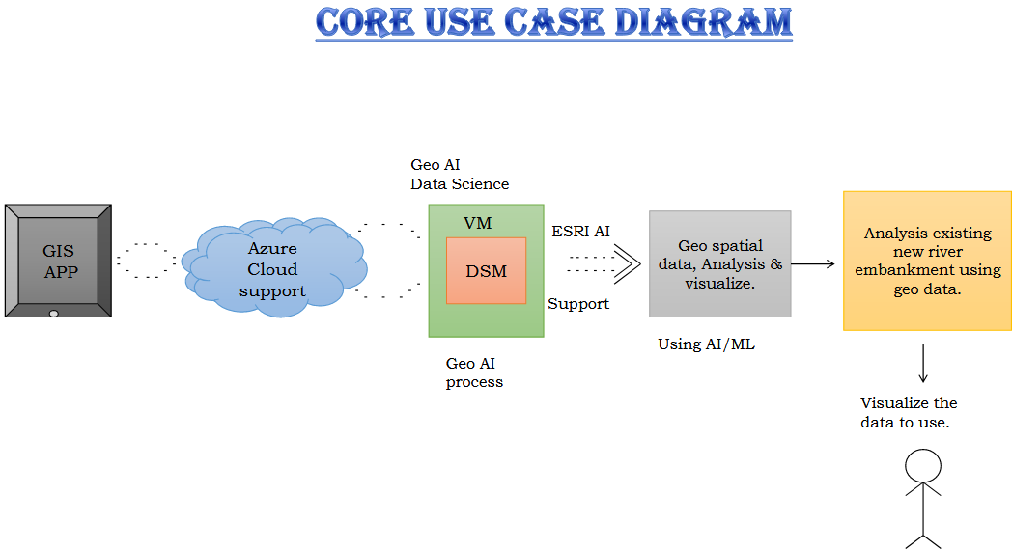

Slide 3
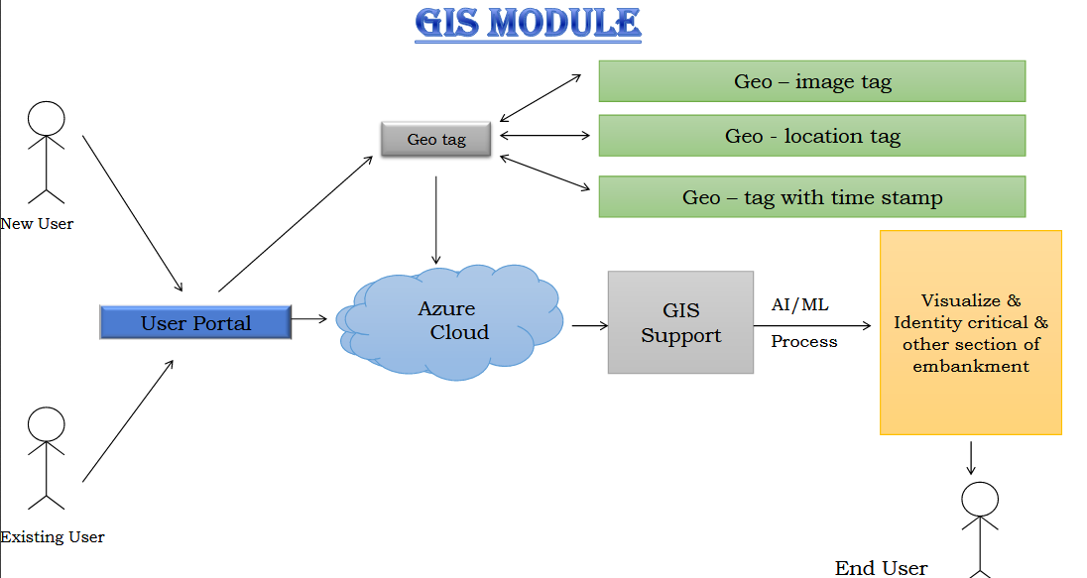

Slide 4
